Slide 1
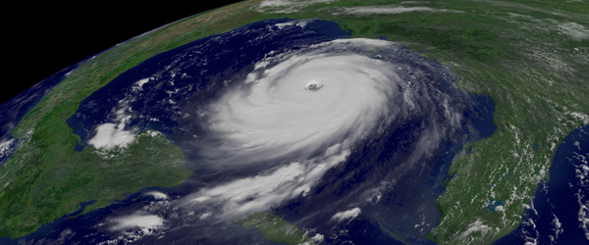
Hurricane Severity Index and Severity Prediction
Julian Sneve
Data Science Capstone Project
https://github.com/jabsneve/hurricanes_capstone

Slide 2
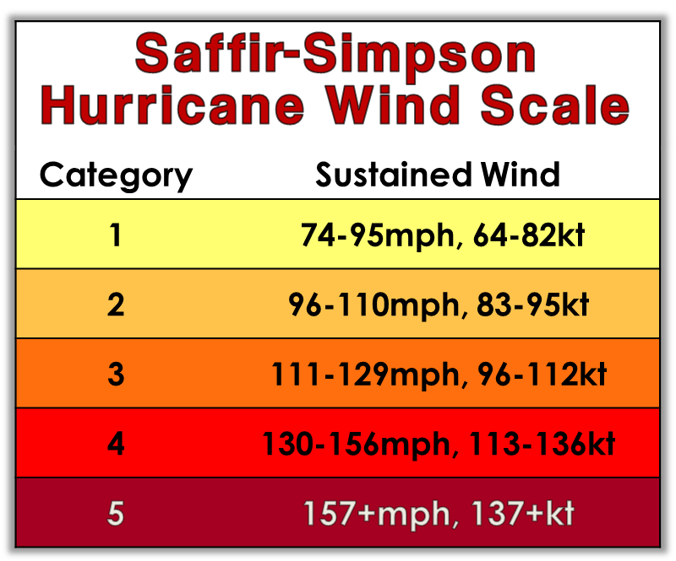
The Problem: Saffir-Simpson Wind Scale
Created in 1973
Only ranks hurricanes based on wind speed
Fails to account for other characteristics such as size

Slide 3

Is a new ranking system necessary?
Growing population in Southeast United States
Accurate storm severity predictions can help with:
Evacuation mandates
Infrastructure planning
Saving lives
Atlantic Ocean
Gulf of Mexico

Slide 4
Hurricane Severity Index
Created in 2006 by Chris Hebert and Bob Weinzapfel
Accounts for wind speed and wind field size of storms

Slide 5
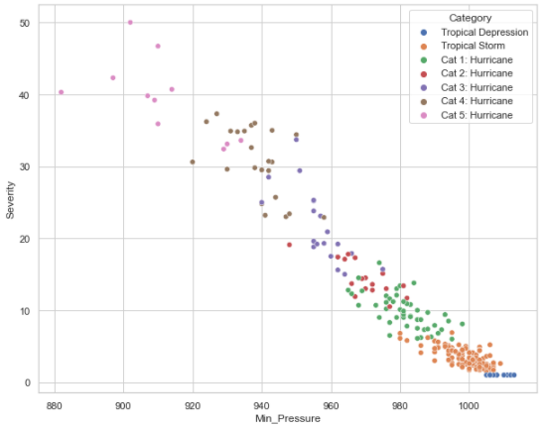
Saffir-Simpson vs. Hurricane Severity Index
Plenty of mixing between storm categories

Slide 6
Data
National Hurricane Center (NHC)
HURDAT2 Dataset
Post-storm analysis
1851 – 2019
53,733 observations
Removed pre-2004 data
Lacked wind speed radii

Slide 7
Feature Engineering
Intensity Points
1-25 point scale
Based on wind speed only
Size Points
1-25 point scale
Based on total wind field
Multiple features created for severity calculation

Slide 8
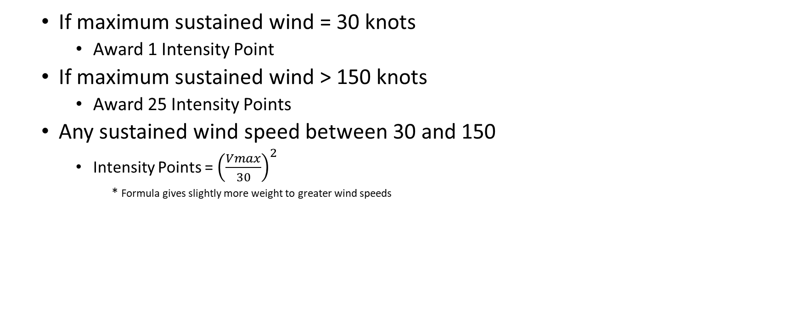
Calculate: Intensity Points
If maximum sustained wind = 30 knots
Award 1 Intensity Point
If maximum sustained wind > 150 knots
Award 25 Intensity Points
Any sustained wind speed between 30 and 150
Intensity Points = ${\left(\frac{Vmax}{30}\right)}^{2}$
* Formula gives slightly more weight to greater wind speeds

Slide 9
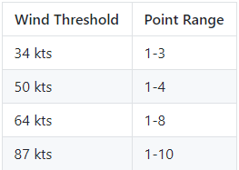
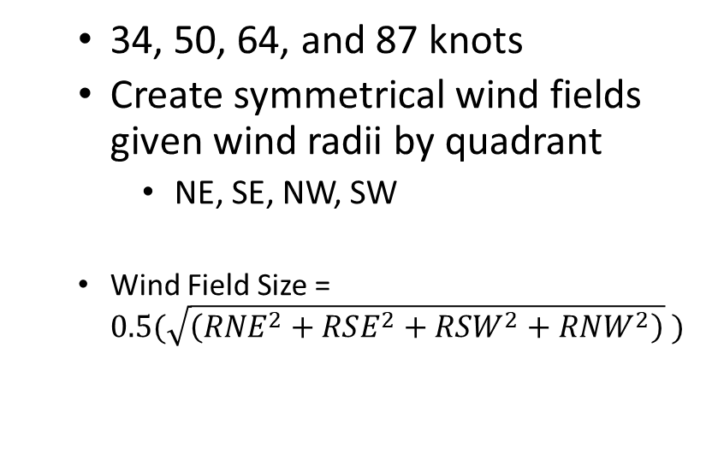
Calculate: Size Points
Find wind field size for 4 speed thresholds
Award size points for each threshold size
34, 50, 64, and 87 knots
Create symmetrical wind fields given wind radii by quadrant
NE, SE, NW, SW
Wind Field Size = $0.5(\sqrt{\left(RNE^{2}+RSE^{2}+RSW^{2}+RNW^{2}\right)} )$
Sum the awarded points for each threshold for total size points

Slide 10
Calculate: Severity Points
Hurricane Severity Points = Intensity Points + Size Points

Slide 11
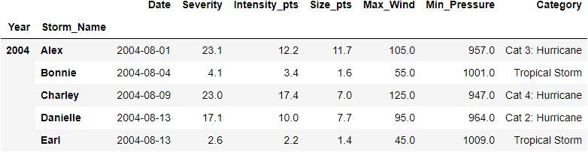
Create Concise Dataframe
Includes
Intensity points
Size points
Severity points

Slide 12
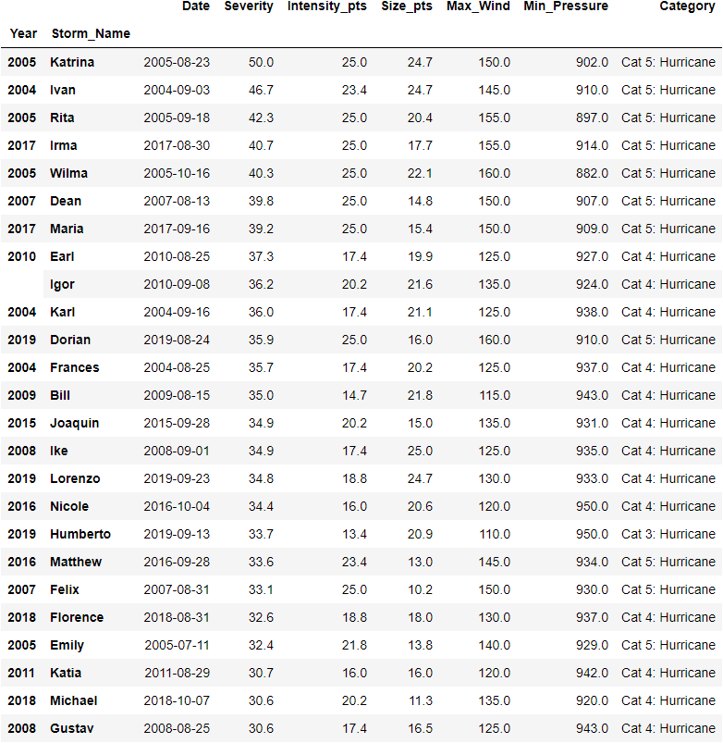
Top 25 Storms Based on Severity

Slide 13
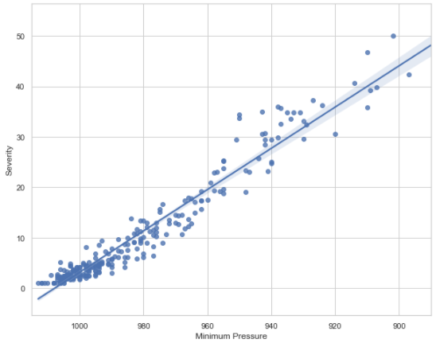
Machine Learning Overview
Used two methods of supervised learning
k-Nearest Neighbors
Predict Category based on barometric pressure
Linear Regression
Predict continuous Severity based on barometric pressure

Slide 14
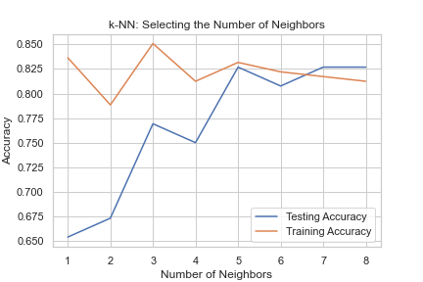
k-Nearest Neighbors
Scikit-learn’s KNeighborsClassifier
Split the data
80% Training set
20% Test set
Tested number of neighbors 1-9
5 produced the best results on both sets

Slide 15
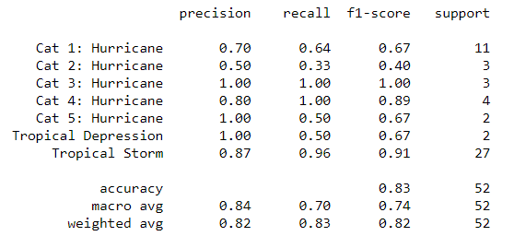
k-Nearest Neighbors
Used Scikit-learn’s classification_report to see full results

Slide 16
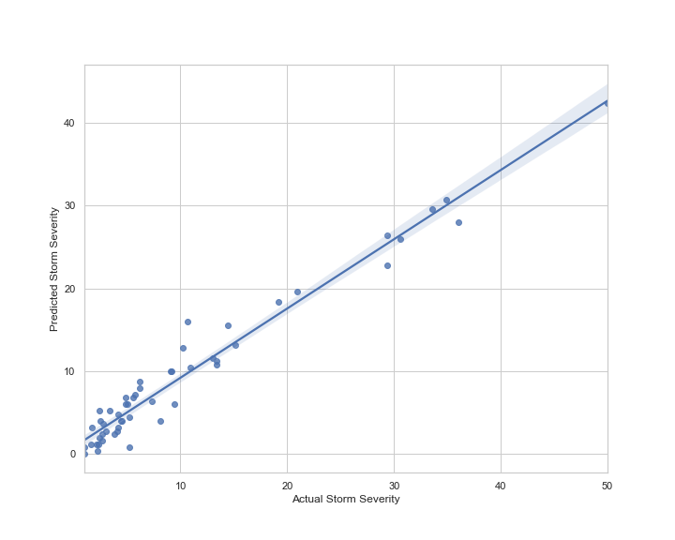
Linear Regression
Scikit-learn’s LinearRegression
Split the data
80% Training set
20% Test set
Scikit-learn’s cross_val_score
4-fold cross-validation
Average score: 93.3%

Slide 17
Conclusion and Improvements
Barometric pressure is a valuable feature for storm prediction
The Hurricane Severity Index can be useful for future storm classification
More data can certainly help create more robust models
More historical data going further back than 2004
More features:
Sea surface temperature
Ambient air temperature
Humidity levels
Jet stream location

Slide 18
Thank you
Julian Sneve
Email: jack.sneve@gmail.com
LinkedIn: https://www.linkedin.com/in/juliansneve/
Github: https://github.com/jabsneve

